Slide 1

Study of the Obesity Rates in the united states
Fahad Almunif

Slide 2
Project Description
project will be about socioeconomic impact on obesity levels for a sample of people living across the United states. The ones benefitting from the study is the health industry and the citizens by considering the common factors or keys that indicate an increase in the obesity for certain individuals.
The scope of the project or the questions I hope to find an answers to from the study:
  Q: How does the economy affect obesity?
  Q: which states suffer from obesity the most?
  Q: what is some approaches that might limit the obesity levels?

Slide 3
dataset
The data contains 53392 entries which corresponds to each state for different years and different people, it also contains 33 features such as the year that the study was conducted, the location abbreviated and spelled out, the data value and some survey questions, it also has information regarding the income levels, education levels, gender and Race/Ethnicity. we will not be using all the features because it contains more than what we need, our goal is to investigate the education and income connection to the obesity only.
The data was obtained from Kaggle and originally the data is from the Behavioral Risk Factor Surveillance System.

Slide 4
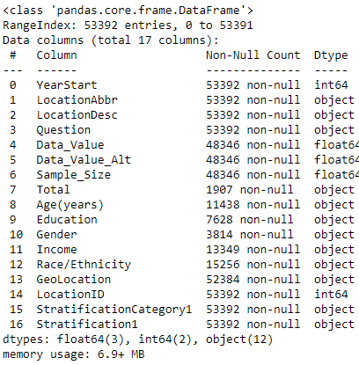
Dataset - Features
YearStart & YearEnd: the years 2011 – 2016
LocationAbbr & LocationDesc: the location (states)
Datasource: Behavioral Risk Factor Surveillance System
Class & Topic: Obesity / Weight Status
Question: survey questions to be answered
DataValue: obesity level
Age, education, gender, income, race/ethnicity
Stratification1: holds the gender, levels for education and income

Slide 5
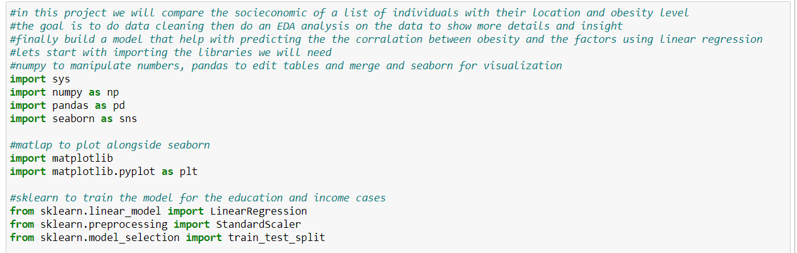
Tools

Slide 6
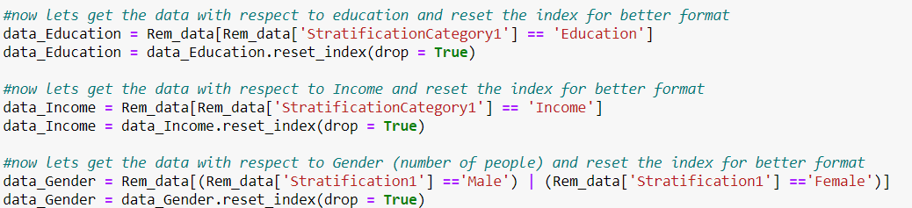
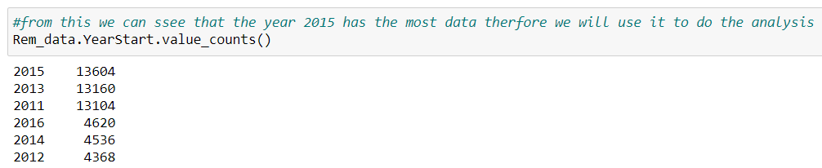
Process - Analysis

Slide 7
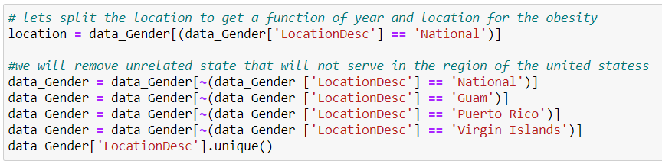
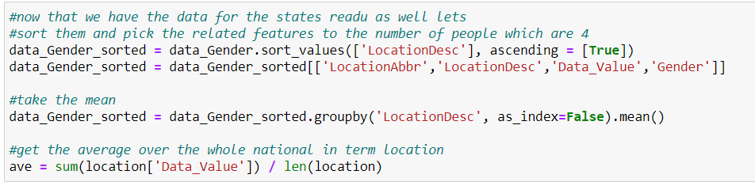
Process – obesity rate per state

Slide 8
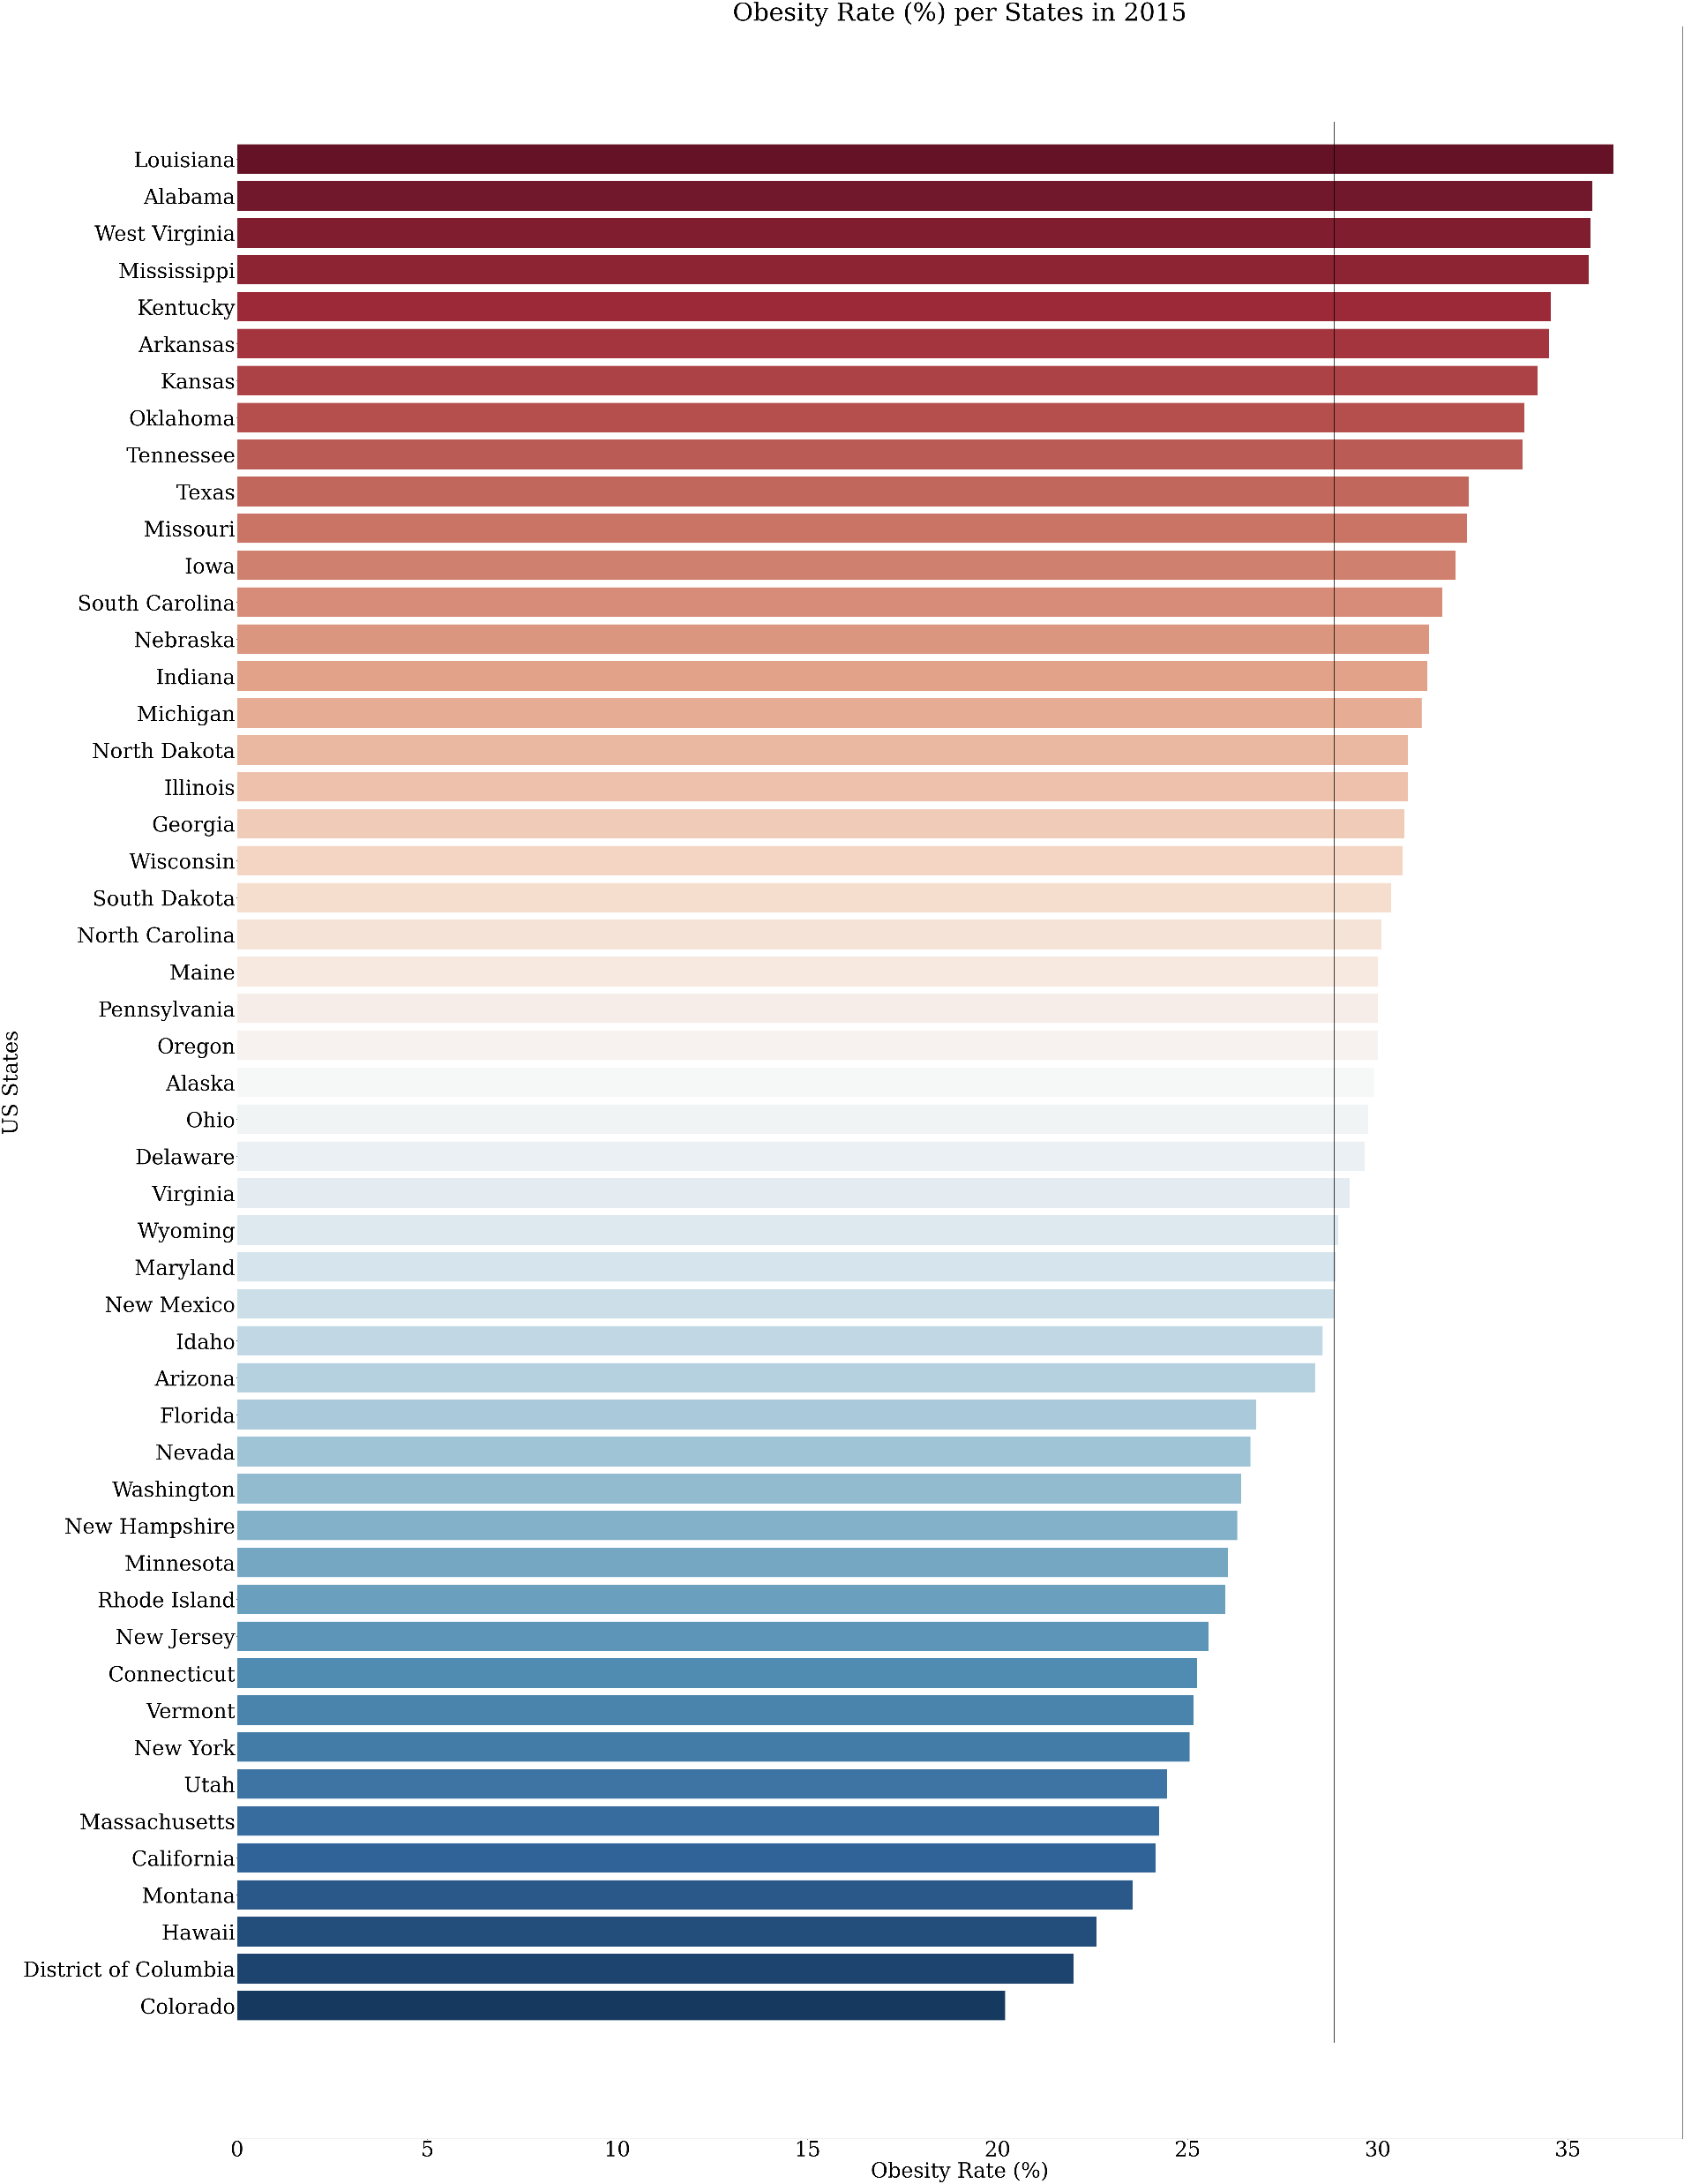
The average Obesity Rate per States in 2015 is 28.85 %

Slide 9
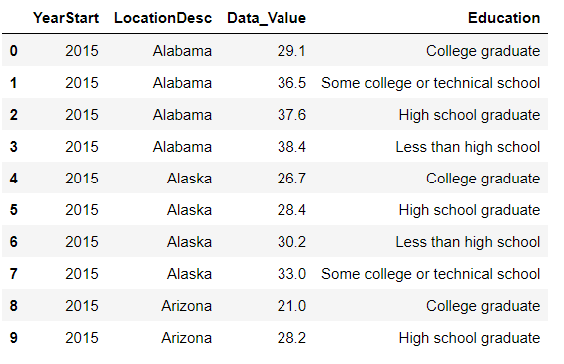
Process – obesity rate per education level
['College graduate' 'Some college or technical school’
'High school graduate' 'Less than high school']

Slide 10
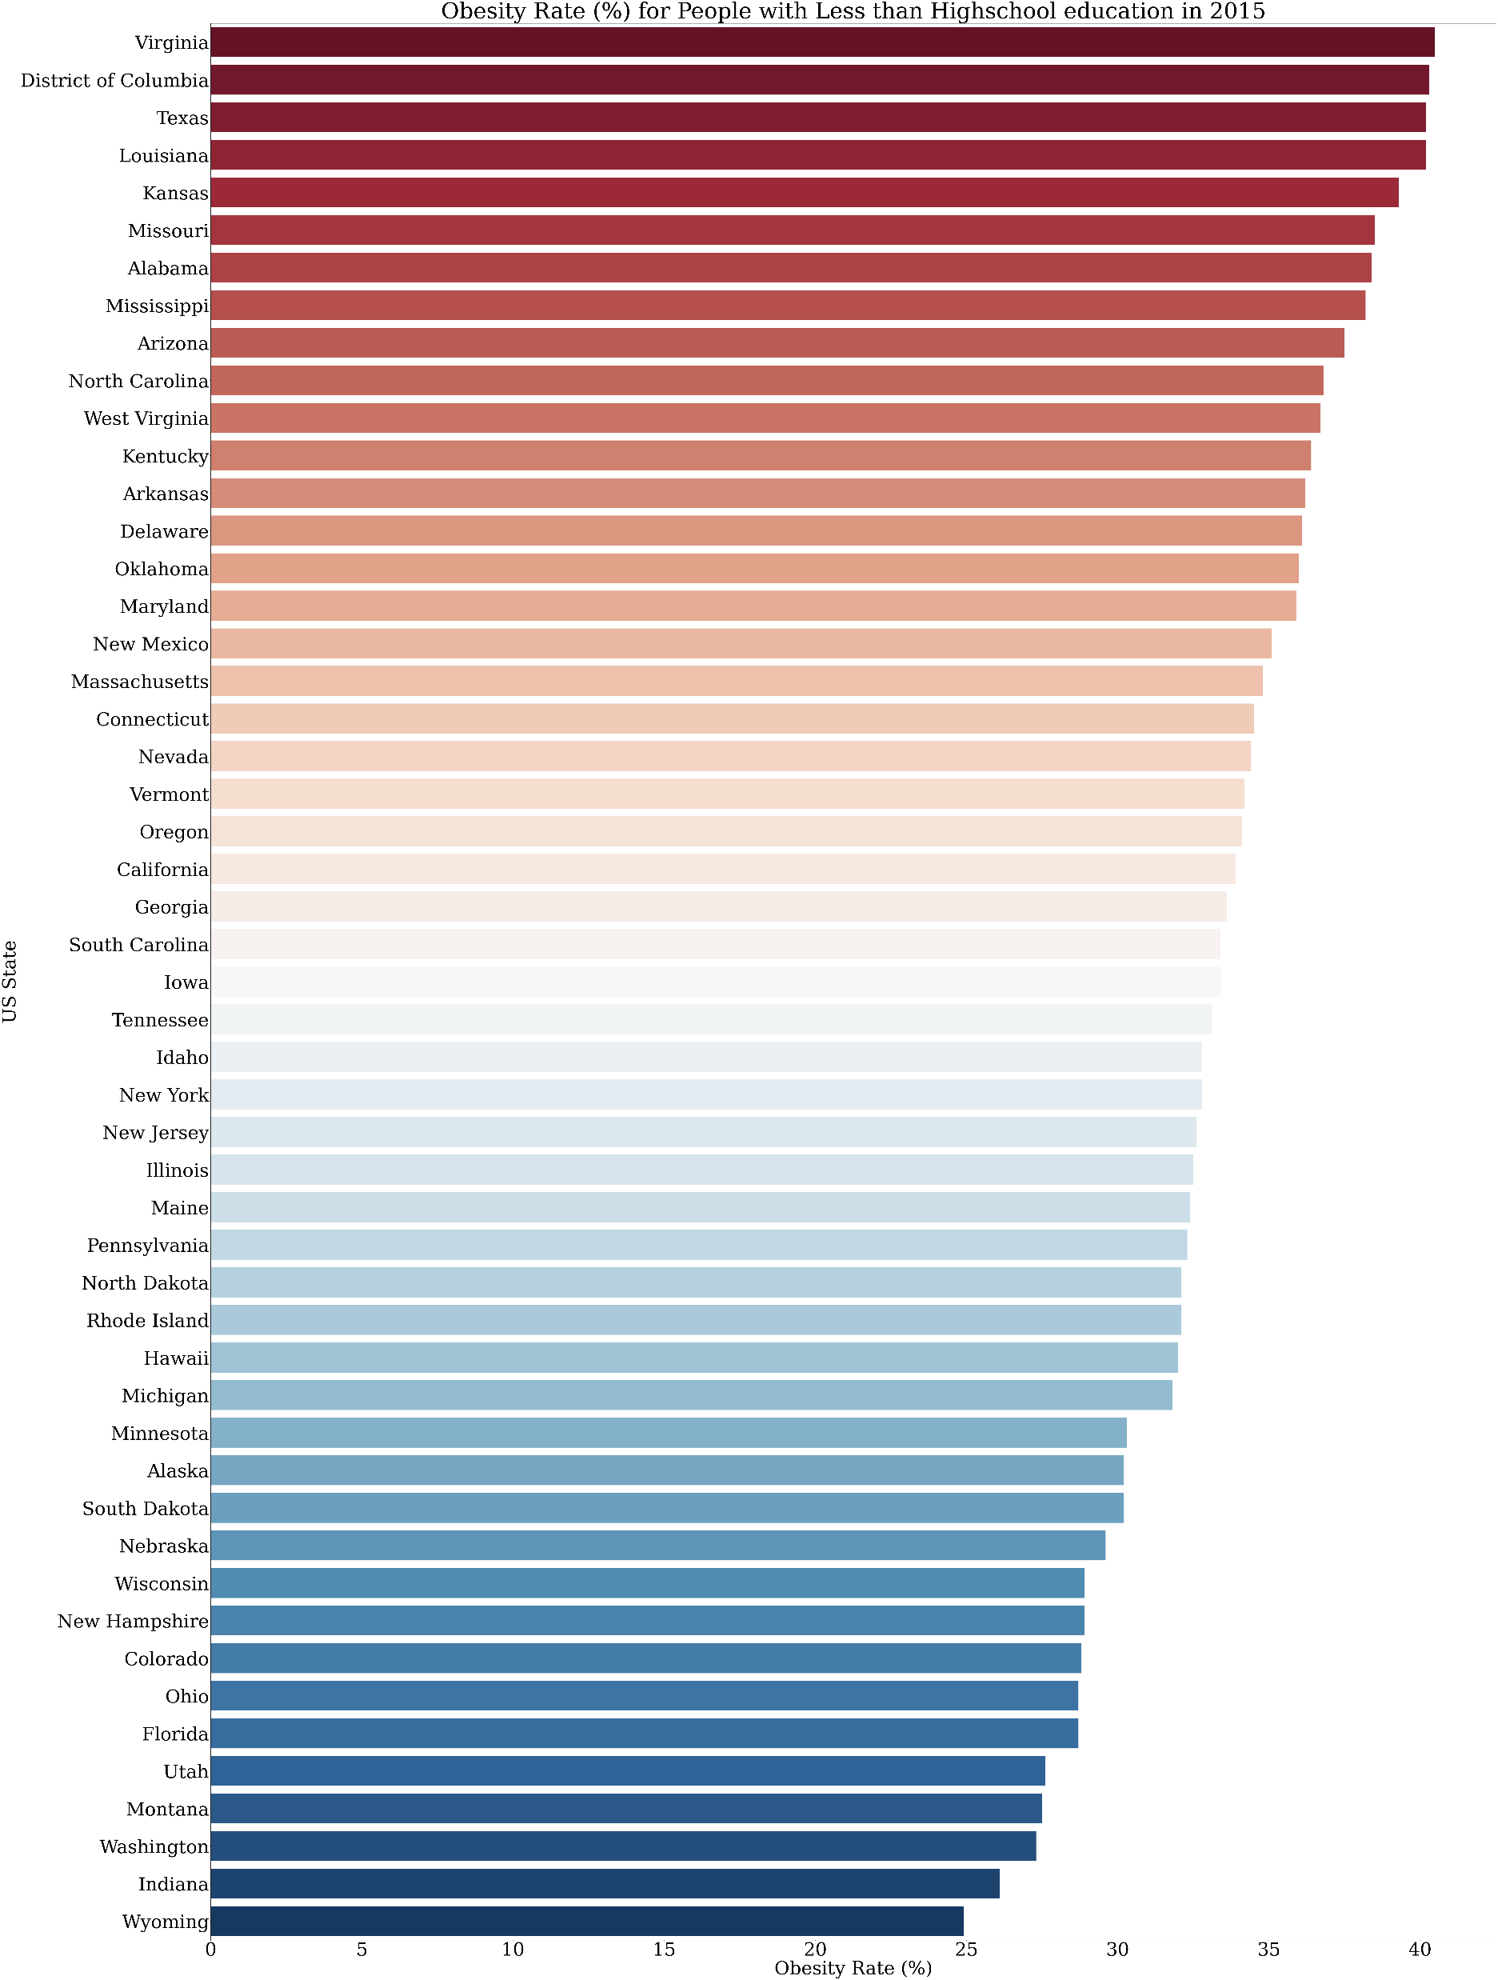

Slide 11
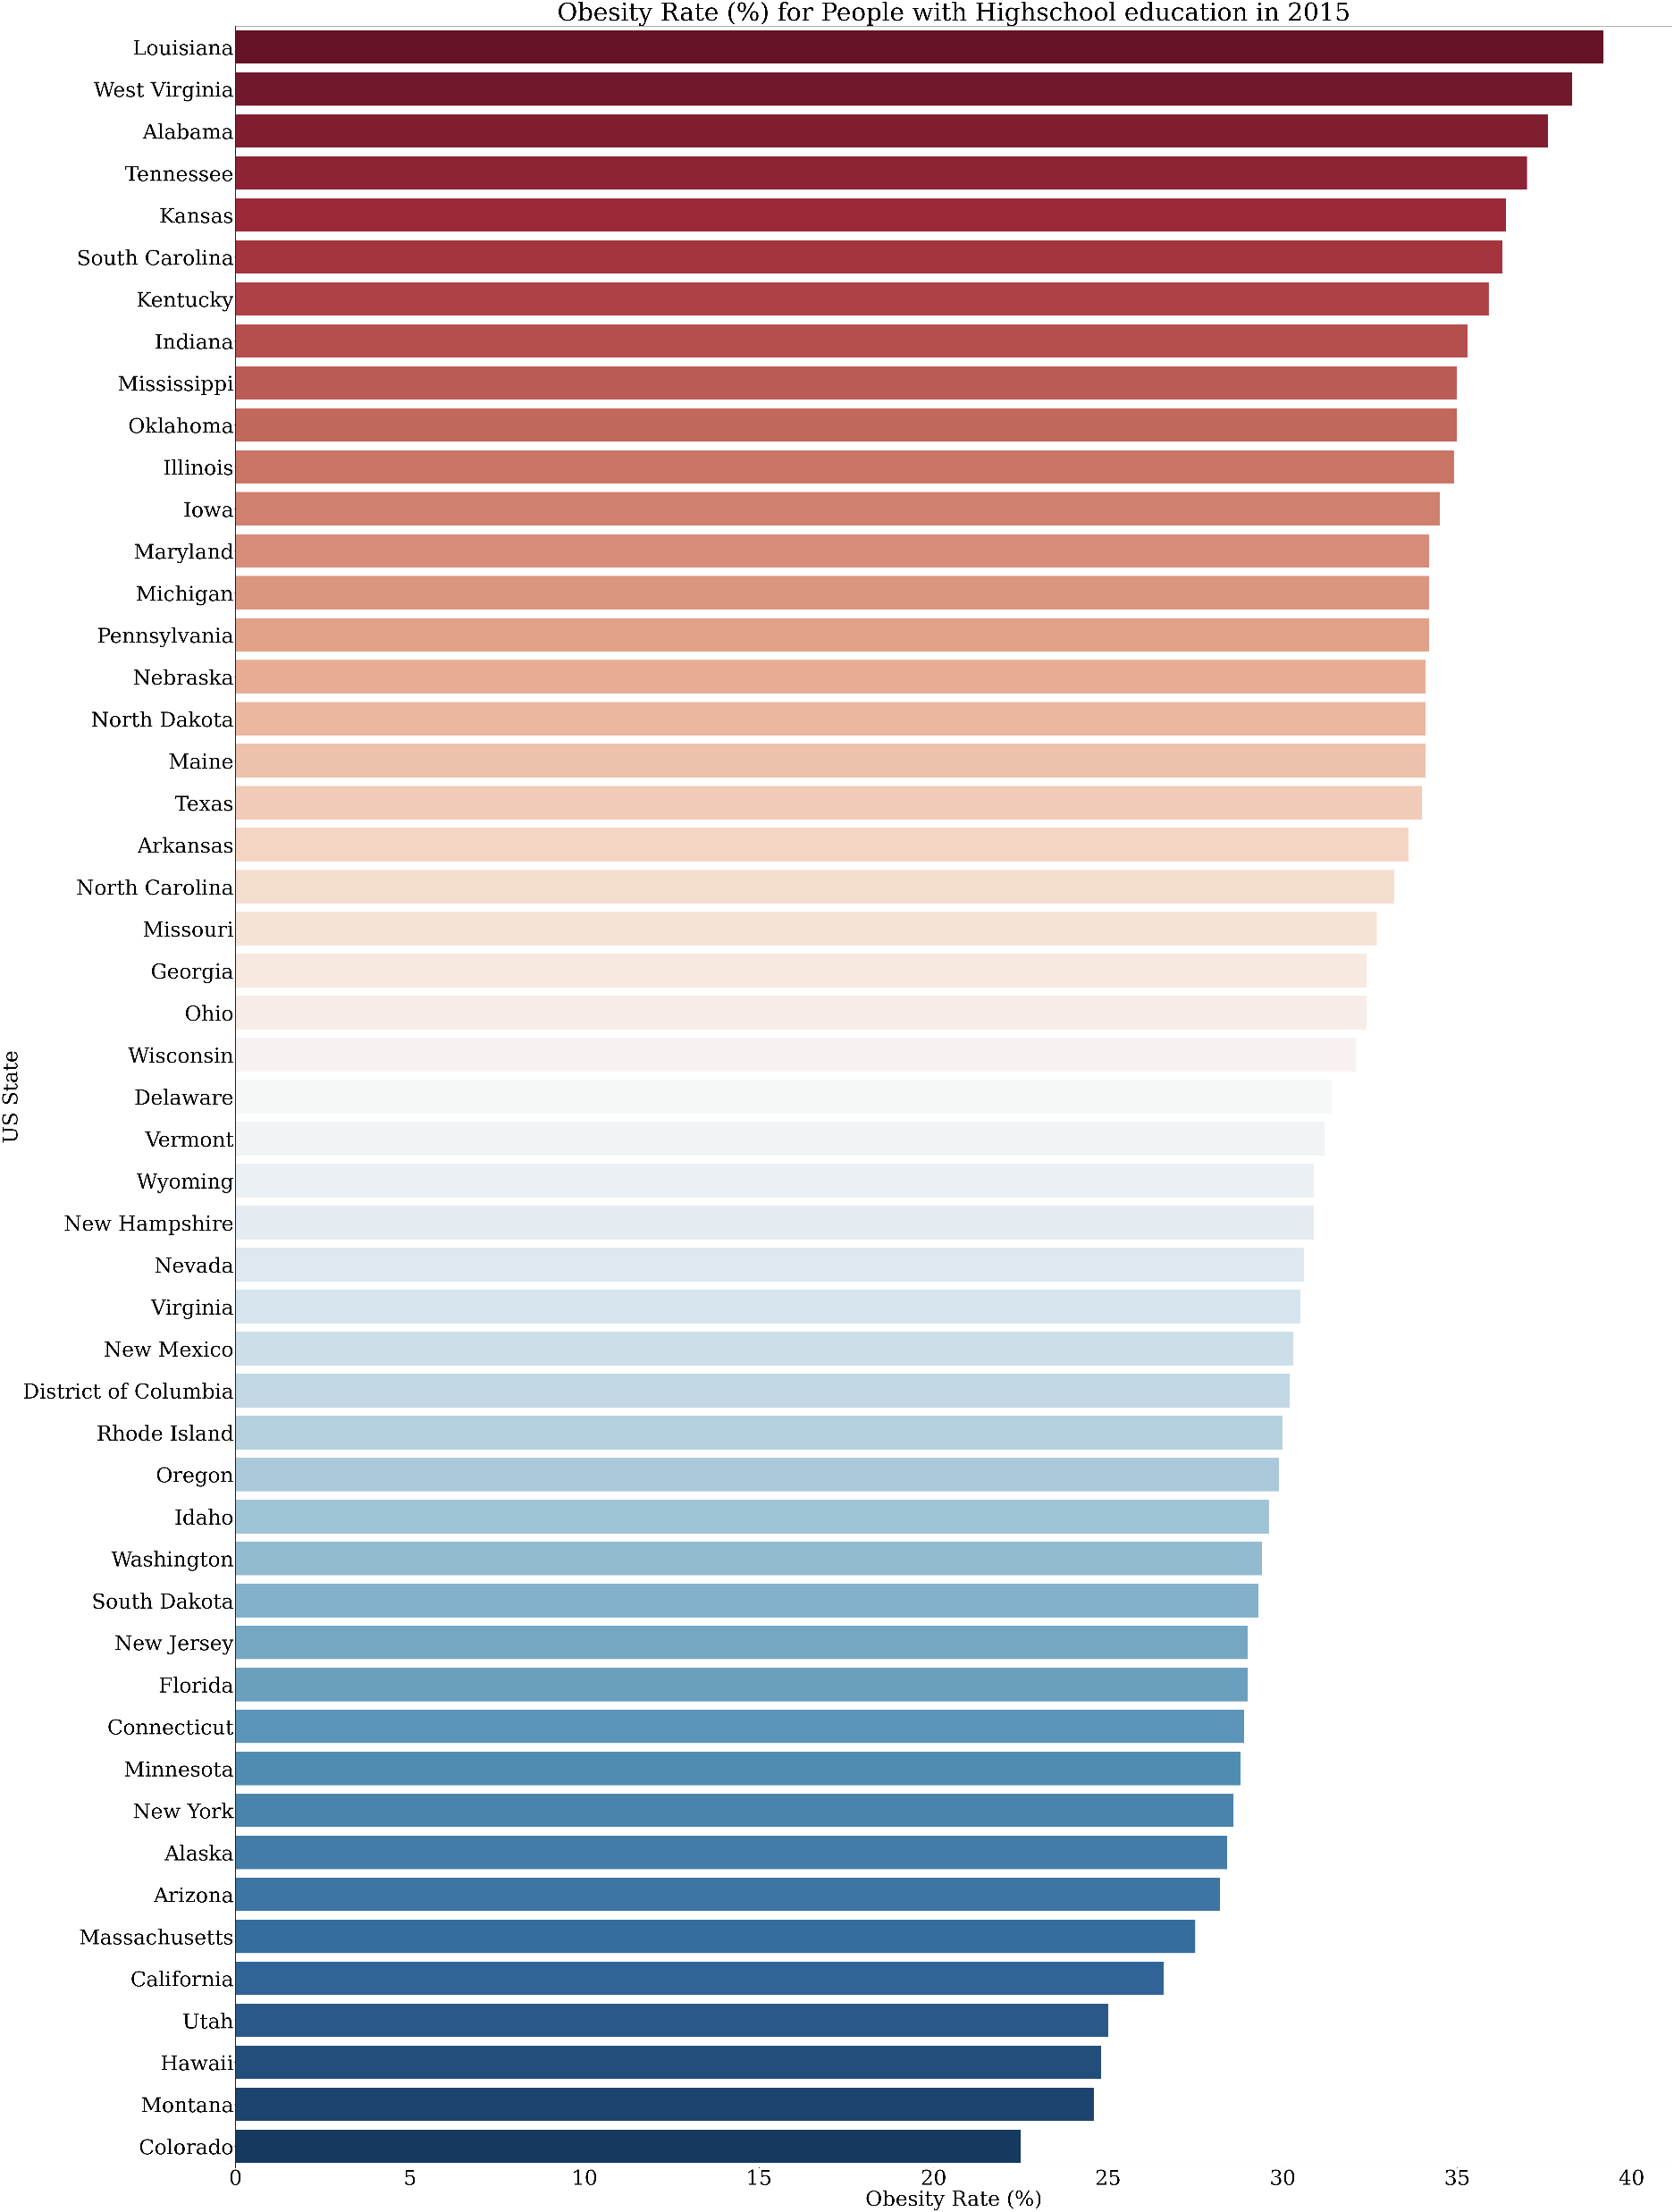

Slide 12
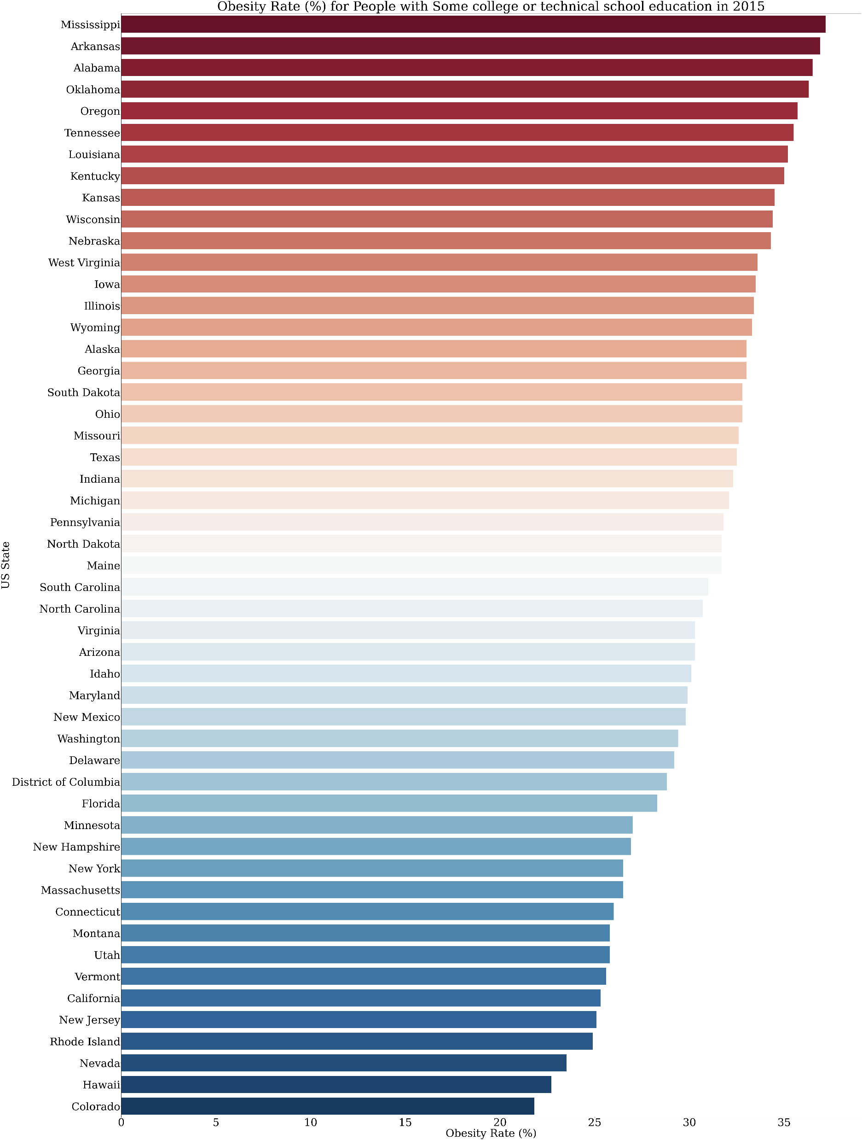

Slide 13
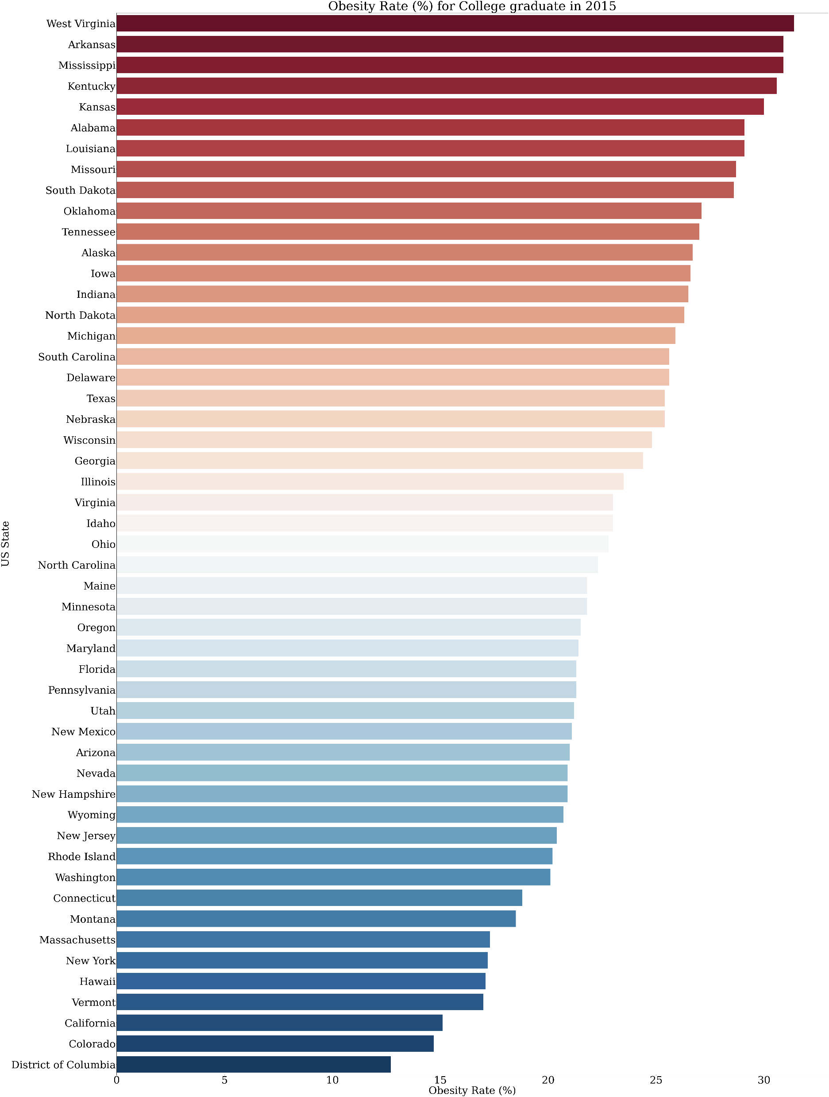

Slide 14
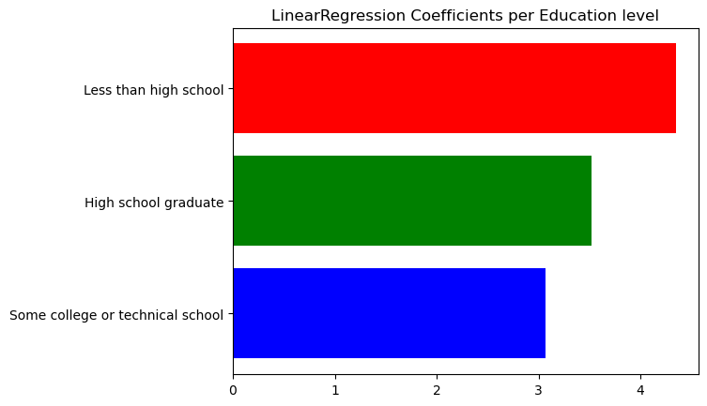
Process – linear regression coefficient
R^2 to show how much of the linear model it correlate to yielded:
48% which is considered good for a new study

Slide 15
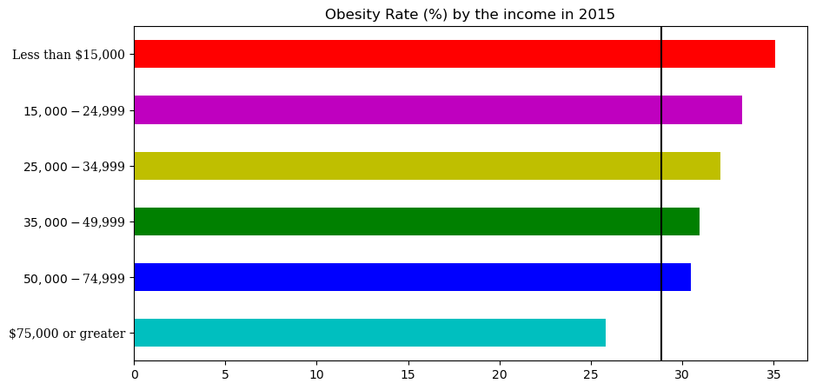
Process – obesity rate per income

Slide 16
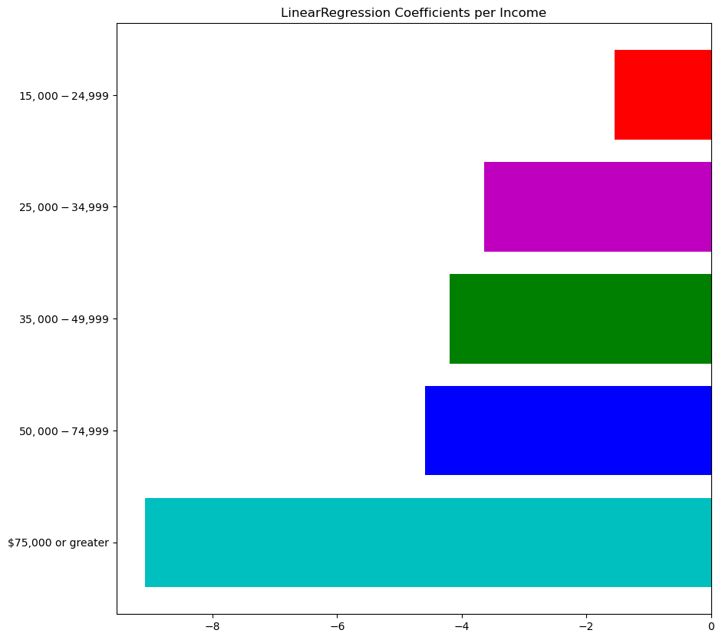
Process – linear regression coefficient
R^2 to show how much of the linear model it correlate to yielded:
30% which is considered acceptable for a new study

Slide 17
☺
Thank you for listening

